Slide 1
Secular Student Alliance (UGAtheists)
Matthew Vollkommer

Slide 2
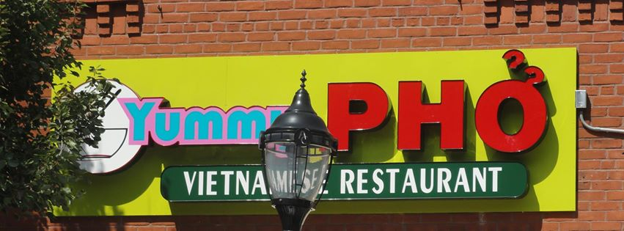
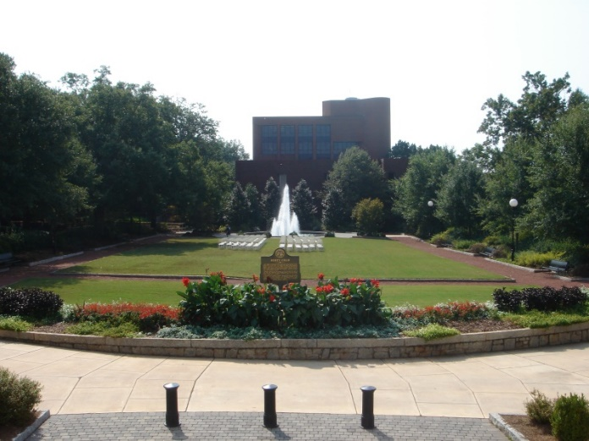
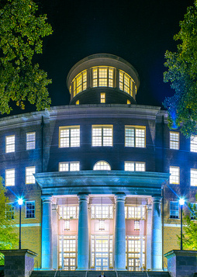
Observation
6 boys + 6 girls = 12 white people
Ages 17-25
“Speed Friending” for Halloween
1 minute per person
Rotate around a table
Create a sense of community
Walk together to Yummy Pho
Ate food together

Slide 3
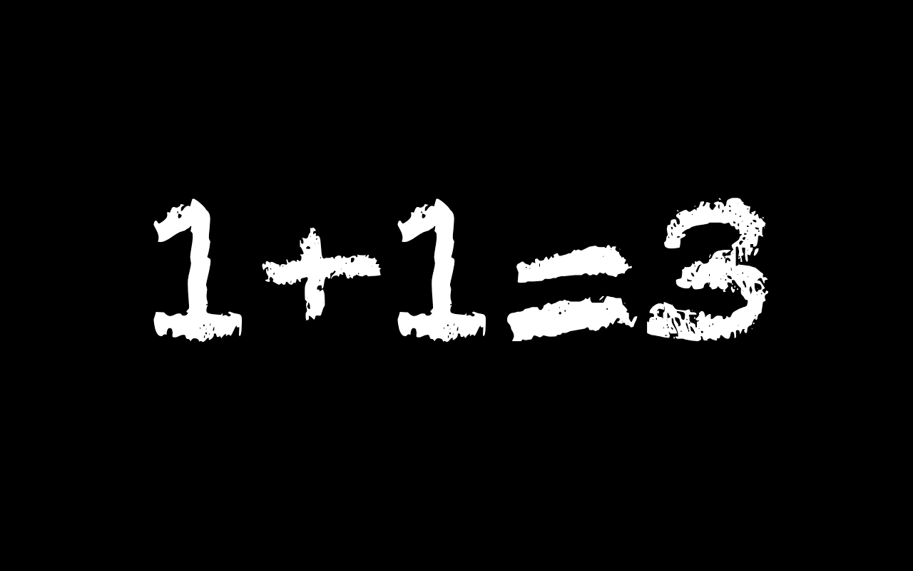
Interview
Chris
From a religious family
Dissuaded from the Church
Didn’t like predestination
Hazing common
Church snobs
Illogical
Loneliness
Bible doesn’t make sense
Hypocrisy amongst church member

Slide 4
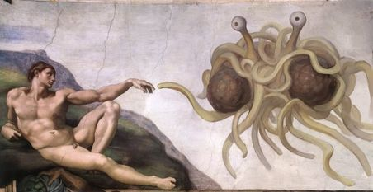


Analysis
“God is Society writ large” - David Émile Durkheim
Bricolage
Speed friending ~ Speed dating
Potluck ~ Thanksgiving
Corn Maze ~ Halloween/Fall Fun
Symbols drawn from elsewhere
Personal Symbols
Tea Kettle – Russell’s teapot
Equal Sign – Gay Rights
Spaghetti Plate – FSM of Pastafarianism

